Slide 1
Verbal and non-Verbal Communication

Slide 2
“Verbal Communication.”
We may often think that, having good communication skills is all about the ability to speak well…..
Or all about “SPEAKING.”

Slide 3
We are right……
But only 50% right.
Because….
Verbal Communication has another very important part…… “LISTENING”.
“Speaking” + “Listening” = “Verbal Communication.”

Slide 4
Broadly, LISTENING may be classified into…
Sympathetic Listening
and
Empathetic Listening.

Slide 5
Sympathetic LISTENING…
In sympathetic listening we care about the other person and show this concern in the way we pay close attention and express our sorrow for their ills and happiness at their joys.
In other words there is “sharing” of feelings.

Slide 6
Example for sympathetic listening…
On your way back from office, you slip and fall and hurt your back. When you reach home your family members “Feel” for you.
They “share” your hurt feelings and maybe even shed a tear in sympathy.

Slide 7
Empathetic LISTENING…
When we listen empathetically, we go beyond sympathy to seek a truer understanding of how others are feeling. This requires excellent discrimination and close attention to emotional signals. When we are being truly empathetic, we actually acknowledge what they are feeling.
In order to get others to expose these deep parts of themselves to us, we also need to demonstrate our empathy in our demeanor towards them, listening sensitively and in a way that encourages self-disclosure

Slide 8
Example for empathetic listening …
On your way back from office, you slip and fall and hurt your back. You visit your doctor.
Your doctor does not share your feelings.
He does not reject or trifle your feelings, but on the contrary, he acknowledges your feelings totally and treats you for your injuries.
Here, there is no “sharing” of feelings, but acknowledgement of “feelings.”

Slide 9
Speaking consists of two parts…
1) “What to Speak.”
and
2) “How to Speak.”

Slide 10
1) “What to Speak.”
Content development:
*The first step is Brainstorming.
*The next step is to choose a Presentation Format/ Storage System.
*The Final step is the Presentation itself.

Slide 11
Brain Storming…
Individual Brainstorming is the process of you getting your ideas out on paper.
The idea is to put down all of / most of your ideas on paper. This has two advantages.
1.It encourages the unrestricted flow of thoughts.
2. It facilitates the strategic or comparative evaluation of your ideas .ie. Once on paper, you have the opportunity of ranking your ideas in terms of importance and efficacy. You may now put your ideas against one another and choose the best ones.

Slide 12
Putting them all together…
Now that we know what we are going to speak, we need to put down all our ideas in the most presentable manner.
We need a Format as per which we may
present these Ideas. We may call it a Presentation/Display Format or a Storage System.

Slide 13
Need for Storage Systems…
Asked a question, “Do we forget due to nervousness or Do we get nervous due to forgetting?”
Eg. “What if you had to recite the alphabet in front of an audience?”…
“would you get nervous?” … “Obviously Not!”
Or…

Slide 14
Why do we get Nervous?
Nervousness does not cause as much Forgetting as…..
Forgetting causes Nervousness.
*One of the main causes of Nervousness is “Forgetting”, or rather, “The Fear of Forgetting”.
*In other words, we would not get nervous if we knew for certain that we would not forget…our lines.

Slide 15
So, to prevent forgetting, we need …
A Good Storage System or
A Good Retrieval System….
A Good Storage System or Display Format, also makes it easy for our listeners to understand our Ideas easily.
Let us check out a few of these “Filing Systems.”

Slide 16
Storage System 1
IBC…Introduction, Body, Conclusion format…
1.Introduce the Topic or what you are going to say.
2.In the Body, add a few Supporting ideas to build further.
3.End with appropriate Conclusion.

Slide 17
Storage System 2
WHPI…
1.What… Begin with the End/Conclusion….
2.How….How do we support the Conclusion..
3.Prove It…. Using examples/Case Studies/Statistics.
4.Conclude with… I hope I have been able to…..(use conclusion used in the beginning).

Slide 18
Storage System 3
Time Sequence…
1.Start with Reference/Relevance to The Past…
2.Continue with Reference/Relevance to The Present…
3.Project The Future (With Personal Touch).

Slide 19
Storage System 4
+ve , -ve, personal touch
1.Introduction with +ve (advantages/strengths).
2.Continue with –ve (disadvantages/weaknesses).
3.Give your Personal opinion based on how you’ve evaluated the +ve and –ve.

Slide 20
2) “How to Speak.”
Guidelines…
Speed
Clarity
Punctuation
Pronunciation
Familiarity
Fluency
Expression

Slide 21
Speed
Speed….number of words per minute.
While Most Indians speak at 170 to 180 wpm,
their foreign counterparts speak at 110 to 120 wpm.
Slowing down on rate of speech is the first step towards better speech.

Slide 22
Clarity
Clarity…if audible & free of distortion.
Speech should be loud enough to carry to all the listeners.
Voice Clarity can be mastered with regular practice.

Slide 23
Pronunciation
Pronunciation….
Always remember that English is not "phonetic". That means that we do not always say a word the same way that we spell it.
Use a Good Dictionary or work with your Trainer to Correct pronunciation.

Slide 24
Punctuation
Punctuation…use of various kinds of pauses.
Pause at Full Stops.
Pause at Commas.
Pause at Semi colons.
Pause at Interjection marks.
Pause at Question marks.

Slide 25
Familiarity
Familiarity with words used.
Learning new words…
Using known words in new contexts…
Understanding contexts and situations before reading again..

Slide 26
Fluency
Fluency…Able to express easily.
Developing Fluency is a matter of having all the other parameters in place.
Fluency indicates that a comfortable working ability with the language has been established.

Slide 27
Expression
Expression…transforming of ideas into words
Expression of different feelings with words,word stress, tone, pitch and inflection.

Slide 28
Non-Verbal Communication
NVC

Slide 29
Definition of NVC
“All communication other than that involving words and language”
This is fine but could include everything from animal communication to films. For our purposes we will use a more restricted definition:
“Bodily communication, other than words and language”

Slide 30
Forms
Different categories (or types) of NVC
The functions (or uses) of NVC
Before we do this, we need to establish some general points about NVC and its relationship to language and culture

Slide 31
Relationship between NVC, Language & Culture
When travelling, we do not, on the whole, make the assumption that everyone will understand our first and preferred language
Most of us accept we must either learn a new language or rely entirely on verbal signals for communication
We assume we will have no difficulty in decoding non-verbal clues
We need to be aware of the enormous range and diversity of non-verbal behaviour

Slide 32
NVC, Language & Culture
Even in the secure territory of your own familiar culture, care is needed in the interpretation of non-verbal clues
Jumping to conclusions about meanings of non-verbal clues can be dangerous

Slide 33
Categorisation of NVC – Paralanguage
Paralanguage consists of the non-verbal elements that accompany speech. It includes:
The way we speak (also known as prosodic features)
Volume, pitch, intonation, speed of delivery, articulation, rhythm
The sounds we make other than language
Laughter, crying, yawning, sighing, screeching, coughing
Filled pauses such as ‘Mmmm’, ‘Ahhh’, ‘Ummm’
Unfilled pauses

Slide 34
Categorisation of NVC – Physical Appearance
Clothing, hairstyle, make-up, jewellery, tattoos, piercings, glasses, facial hair, accessories such as bags
You only have to think of the huge industries associated with the above examples to recognise the cultural significance of physical appearance

Slide 35
Categorisation of NVC – Physical Appearance
Many societies had (and some still do have) highly regulated codes of dress, often linked to rank and status
It is the body’s capacity to communicate aspects of an individual’s identity which makes us so aware of our physical appearance

Slide 36
Categorisation of NVC – Physical Appearance
Self expression in contemporary culture is also limited by requirements to wear uniforms or to observe dress codes
Not necessarily restricted to schools and public services
Many corporations and organisations expect employees to communicate a corporate rather than an individual identity

Slide 37
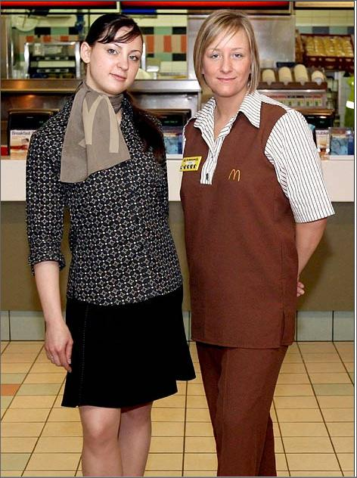
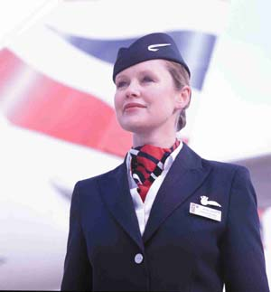

Slide 38
Further Categories of NVC - Activity
_ Body movement (kinesics)
Closeness (proxemics)
Touching
Eye movement
Smells

Slide 39

Body Movement - Kinesics
Gesture, facial expression, posture, head nodding, orientation
Emblems – gestures with specific cultural meanings attached
Illustrators reinforce words of speakers
Adapters are unconscious gestures to relieve stress or boredom
Posture is heavily laden with value judgements

Slide 40
Closeness - Proxemics
Study of how we use space and distance
Includes seating arrangements, queuing and territoriality
Ideas of ‘personal space’, ‘invasion of personal space’ and ‘comfort zones’
Use of objects as ‘markers’ to indicate ownership of space

Slide 41
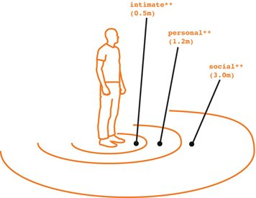
Proxemics

Slide 42
Touching - Haptics
Physical contact such as holding, stroking, shaking hands, guiding
Linked to proxemics
Touch is very important in our early development
Many rules and taboos regulating physical contact

Slide 43

Eye Movement
Eye movement, length and direction of gaze, changes in pupil size
We are hypersensitive to information imparted by eyes
Can be argued eyes reveal the truthfulness of what is being said

Slide 44

Smell
Humans do not have a particularly well-developed sense of smell compared with other species
Perfumes and deodorants send powerful messages, as can the natural body odours we try to suppress
A rapidly growing industry has developed around the use of smells

Slide 45
Complex Messages
Rare for these non-verbal codes to operate in isolation from one another, or separately from language
We create and perceive messages using signs from a range of verbal and non-verbal codes
To make this even more complex, these signs and codes to not always pull in the same direction

Slide 46
Communicative Competence
A competent communicator will:
Recognise and use different verbal and non-verbal styles as they are suited to different social situations
Recognise the relation between verbal and non-verbal elements in communication
Compensate for possible misinterpretations in communication with others

Slide 47
The Functions of NVC
Communicating feelings, emotions and attitudes
Replacing and regulating language
Other Functions

Slide 48
Communicating Feelings, Emotions and Attitudes
NVC has a particularly important role in establishing and maintaining relationships, otherwise known as an affective function
We rely more heavily on NVC in this area of personal communication
Looks, glances, changes in orientation allow others to know what sort of relationship we want to have
We use NVC to establish a mutually acceptable level of intimacy

Slide 49
Replacing & Regulating Language
The role of NVC in inflecting the meaning of a sentence can be explored by ‘performing’ the following sentence in different ways
Well, I really enjoyed the party last night.

Slide 50
Replacing & Regulating Language
Paralinguistic features, such as pitch, tone and emphasis
Throw in other non-verbal cues such as eyebrow lifting or illustrators such as the use of the index and first finger of both hands to indicate inverted commas around a word
Number of potential meanings rapidly increases

Slide 51
Replacing & Regulating Language
Non-verbal cues also make a significant contribution of conversation management
Rules of turn taking allow us to have coherent discussions without constantly talking over the top of each other
Paralanguage, gaze, eye contact and head movement all play a part
It’s a set of rules that takes some time to grasp
Women typically have a more cooperative conversational style whereas men tend to provide less non-verbal feedback

Slide 52
Other Functions
Many other uses to which we put our non-verbal codes including:
- self expression
- group membership
- persuasion
- indicating role

